Slide 1
Capstone Project
www.collaberadigital.com

Slide 2
Personal BACKGROUND
(Name, Past Experience, Qualification, Career Summary)
Name : John Glenn L. Eligio
Past Experience : Team member (Cloud Migration team) - 7 months
Qualification : Java, Spring, Springboot, HTML, CSS, JS, ReactJS
Career Summary :
A programmer that specializes in Web Development, where I use Spring and ReactJS for backend and frontend. As a programmer, is up to date with the current trends with regards to Web development and the updates with regards to the tools I use which are the Spring and ReactJS

Slide 3
Key Takeaways/Learnings from the Program (HTD)
Similarities between the HCL Commerce and the technologies that I am familiar
Spring (Spring Beans)
JPA (@Entity, DaoImpl classes)
MVC Architecture
HCL Commerce Utilities
Dataload
Management Center
Admininstration, Organization, and Accelerator Console
Customization/Extension of OOTB features (Controller/Task Commands, UI) to suit business needs
Customizing the logic for tax calculation by extending the OOTB commands responsible for sales tax calculation
Using ext/ folder and the jspf files inside to add extension logic/ui
Introduction to E-commerce
Different business model (B2B, B2C)

Slide 4
General programming development flow for HCL Commerce
Use the OOTB source code as reference for creating new extension codes
General Troubleshooting
Using the logs from log files and console logs of the servers to check the errors
Using debug and breakpoints to observe process flow of the code
Managing Access Control Policy of Resources
Using acpload.bat in order to modify ACP of Controller Commands
HCL Commerce prerequisite knowledge
Java
Spring
Struts

Slide 5
Problem Statement of the Capstone Project
HCL Commerce (formerly known as WebSphere Commerce and WCS (WebSphere Commerce Suite)) is a software platform framework for e-commerce, including marketing, sales, customer and order processing functionality in a tailorable, integrated package. It is a single, unified platform which offers the ability to do business directly with consumers (B2C), with businesses (B2B), indirectly through channel partners (indirect business models), or all of these simultaneously.
While HCL Commerce provide an out of the box Store (Aurora Store), businesses have different kinds of needs. With this, we will need to be able to customize/extend the current features present in the Aurora Store in order to meet these needs.
In this capstone, we will be able to go through the utilities and customization points available to us in order to modify/customize/extend the Aurora Store

Slide 6
Capstone Problem Statement
Part 1:
Step 1:
Use Dataload utility to populate Field3 and Field4 that will store the Product Rating and Rating Company
Step 2:
Add two fields in the Solr index, and modify the configuration files for Solr to add the Field3 and Field4 of the CatalogEntry table as values of the two fields in Solr:
Step 3:
Use Dataload utility to add new Attribute for CatalogEntry and add these Attribute to some Catalog entries. Also assign values to this attribute
Step 4:
On PDP page, Add product to basket

Slide 7
Capstone Problem Statement
Part 1:
Step 5:
Add Gift wrap service where we can assign gift messages to the item if the catalog entry is gift wrappable
Step 6:
On Confirmation page, display the gift message for the specific order item, if they have gift message attached to it
Part 2:
Step 1:
Add another form in Personal Information page for the Users to be able to save their favourite food and color
Step 2:
Display the information in profile

Slide 8
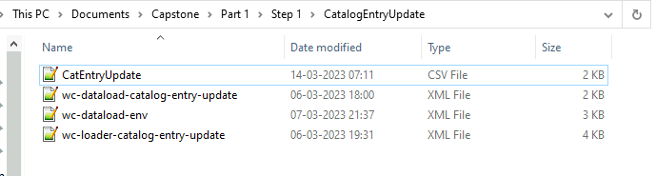
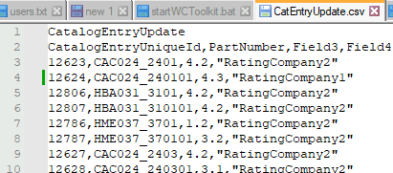
Important areas of the Project with screenshots
Part 1 Step 1
Dataload files for loading Field3 and Field4
CSV input for dataload field3 and field4

Slide 9
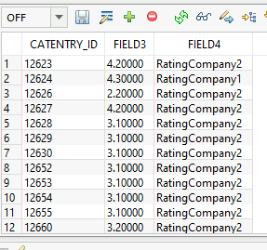
Important areas of the Project with screenshots
Table of the catentry after the dataload

Slide 10
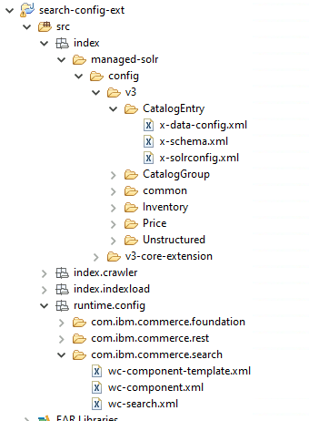
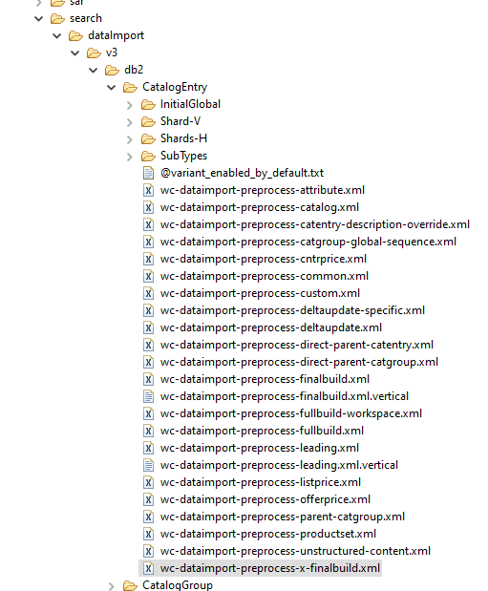
Important areas of the Project with screenshots
Part 1 Step 2
Solr search related files

Slide 11
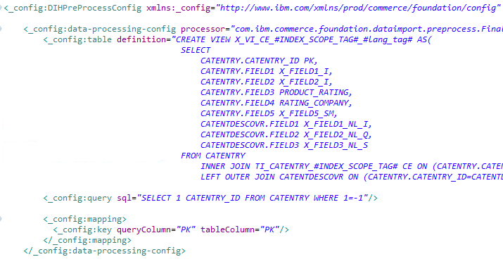
Important areas of the Project with screenshots
wc-dataimport-preprocess-x-finalbuild.xml’s processorConfig where we changed the Field3 and Field4 of CatEntry column to new Alias

Slide 12
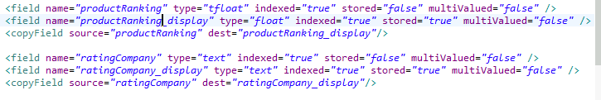
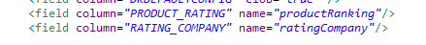
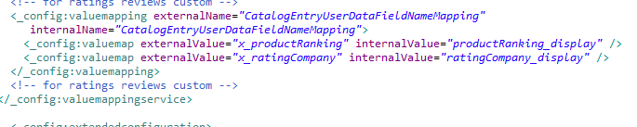
Important areas of the Project with screenshots
x-schema.xml where we added two new custom index fields
x-data-config.xml where we map the temporary table column to index fields
wc-component.xml where we map the index field values to userdata fields

Slide 13
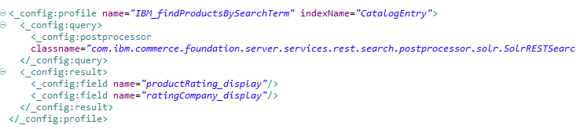
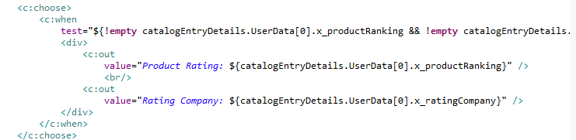
Important areas of the Project with screenshots
wc-search.xml where we created search profile to add solr index field
CatalogEntryDisplay_grid.jspf view where we added ui for displaying product ranking and rating company from userdata

Slide 14
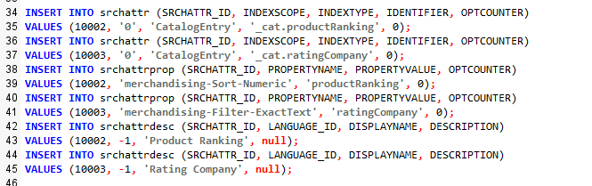
Important areas of the Project with screenshots
Inserting the custom fields in the search related tables in database

Slide 15
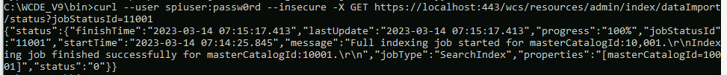
Important areas of the Project with screenshots
CURL command for sending POST request for building index and GET request for checking build index status

Slide 16
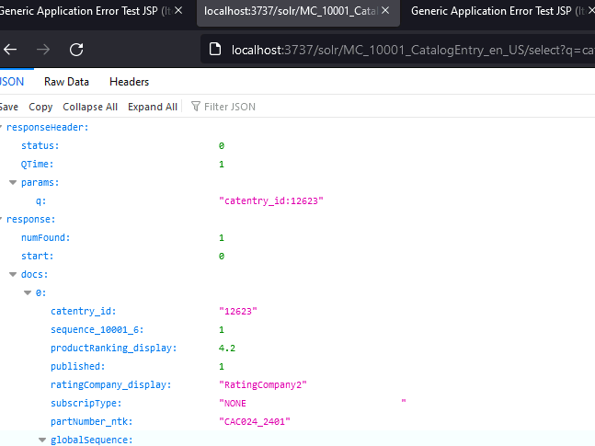
Important areas of the Project with screenshots
Solr index query output

Slide 17
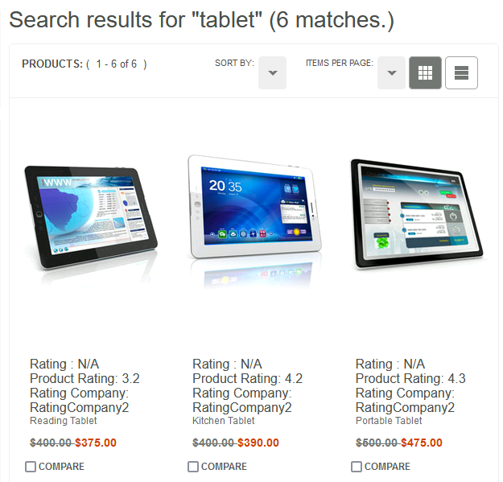
Important areas of the Project with screenshots
Product Rating and Rating Company in Search result page

Slide 18
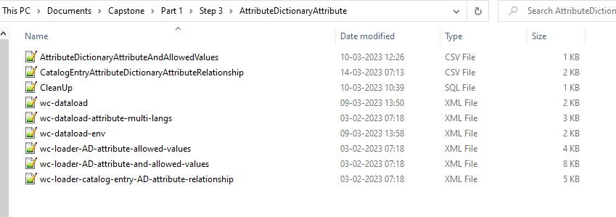
Important areas of the Project with screenshots
Part 1 Step 3
Files for dataloading attributes

Slide 19
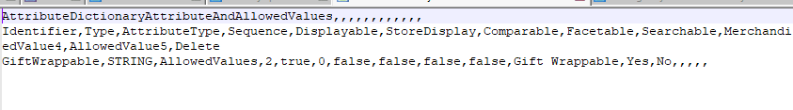
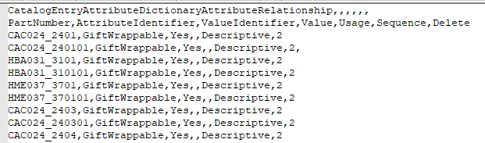
Important areas of the Project with screenshots
CSV input for Attribute to add
CSV input for adding Attribute to Catalog entries

Slide 20
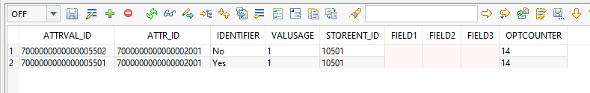
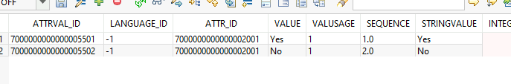
Important areas of the Project with screenshots
ATTR Table
ATTRVAL Table
ATTRVADESCL Table

Slide 21
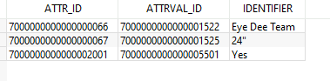
Important areas of the Project with screenshots
CATENTATTRVAL table for catalog entry with part number CAC024_240101

Slide 22
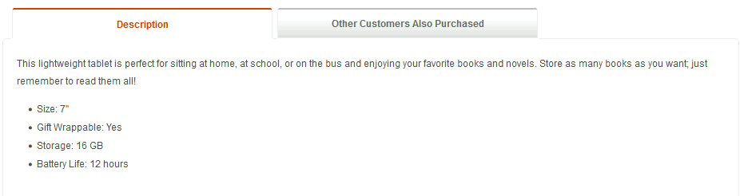
Important areas of the Project with screenshots
Gift wrappable descritpive attribute

Slide 23
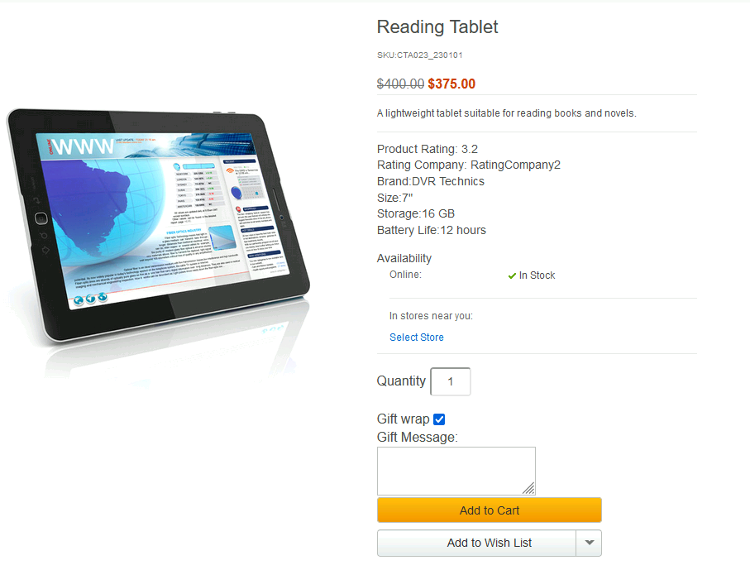
Important areas of the Project with screenshots
Part 1 Step 5
Gift wrap service

Slide 24
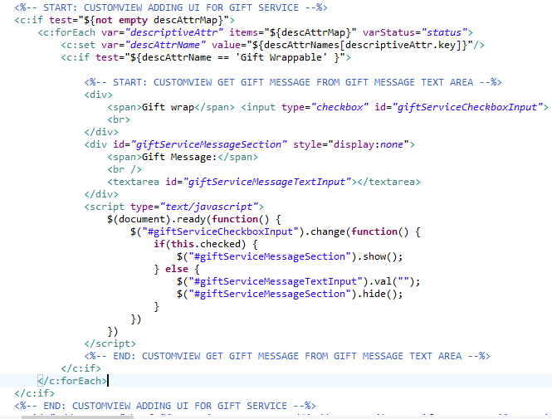
Important areas of the Project with screenshots
ShopperActions_UI.jspf where we added custom ui and logic for gift service

Slide 25
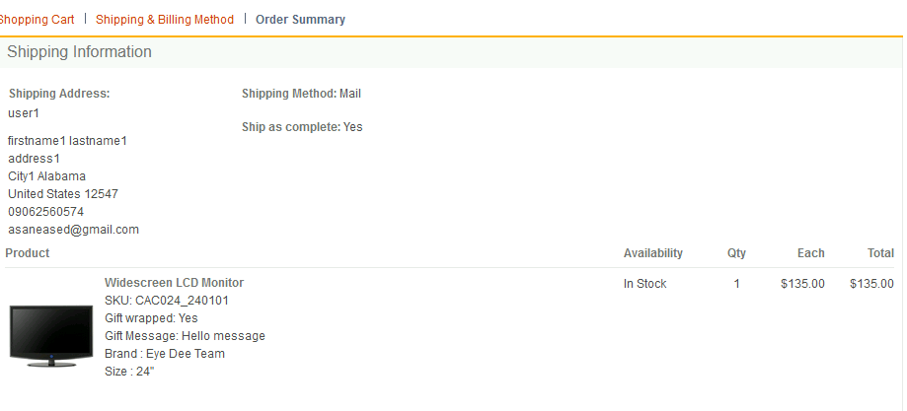
Important areas of the Project with screenshots
Part 1 Step 6
Order summary page

Slide 26
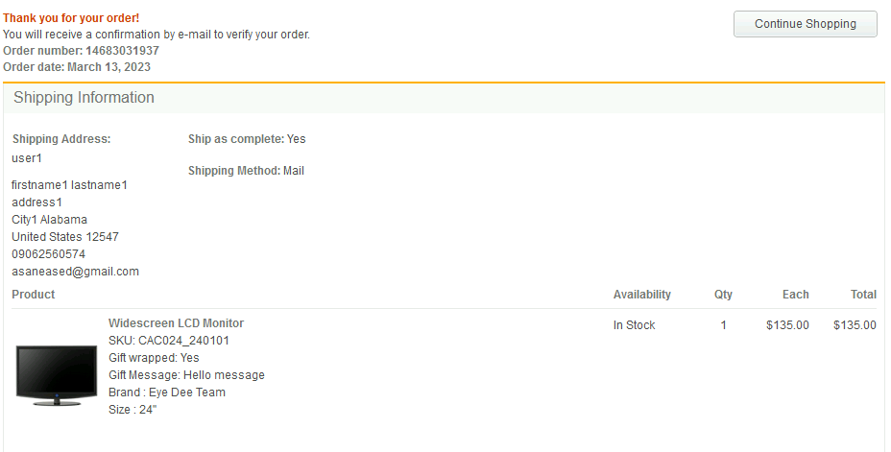
Important areas of the Project with screenshots
Order Confirmation page

Slide 27
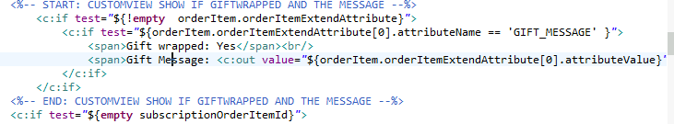
Important areas of the Project with screenshots
OrderItemDetailSummary.jsp where we added custom ui and logic for displaying gift wrapped and gift message

Slide 28
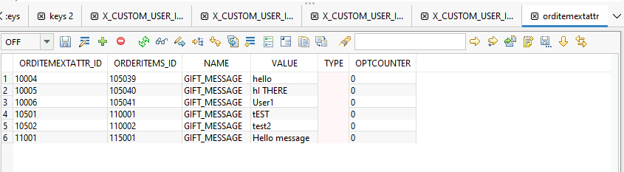
Important areas of the Project with screenshots
ORDITEMEXTATTR table

Slide 29
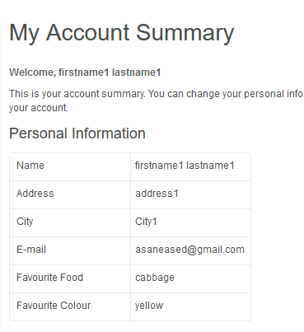
Important areas of the Project with screenshots
Part 2
MyAccountSummary page

Slide 30
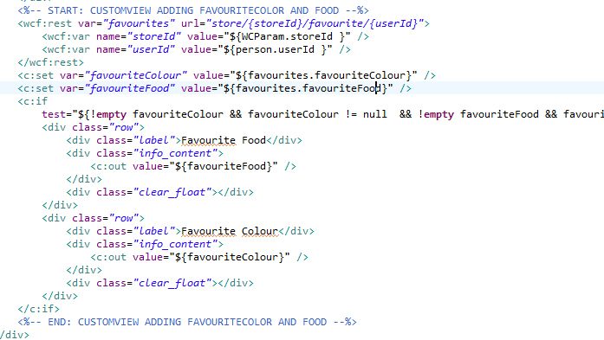
Important areas of the Project with screenshots
AccountSummary_UI.jspf where we fetch the favourite color and food thru rest and display them

Slide 31
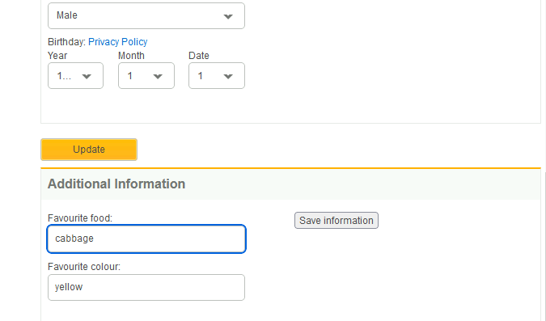
Important areas of the Project with screenshots
Additional information page

Slide 32
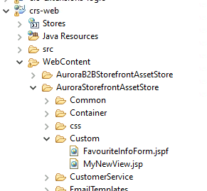
Important areas of the Project with screenshots
Custom jspf file for favourite form

Slide 33
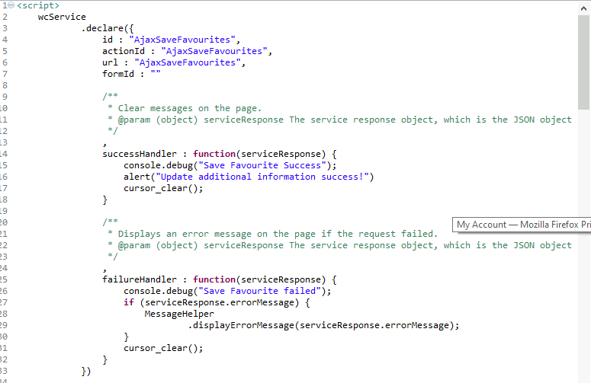
Important areas of the Project with screenshots
FavouriteInfoForm.jspf

Slide 34
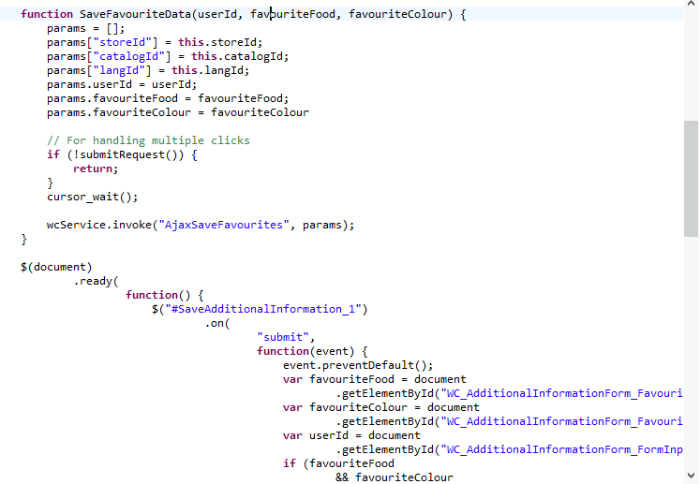
Important areas of the Project with screenshots
FavouriteInfoForm.jspf

Slide 35
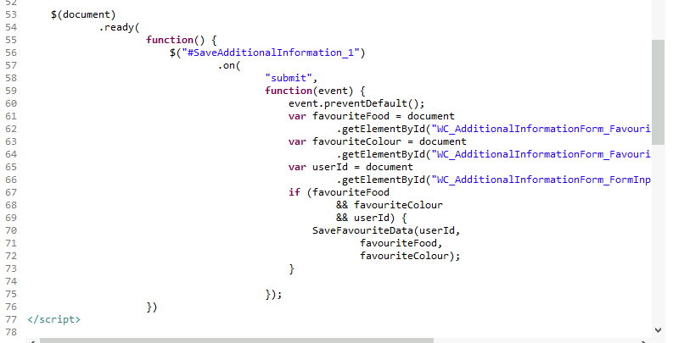
Important areas of the Project with screenshots
FavouriteInfoForm.jspf

Slide 36
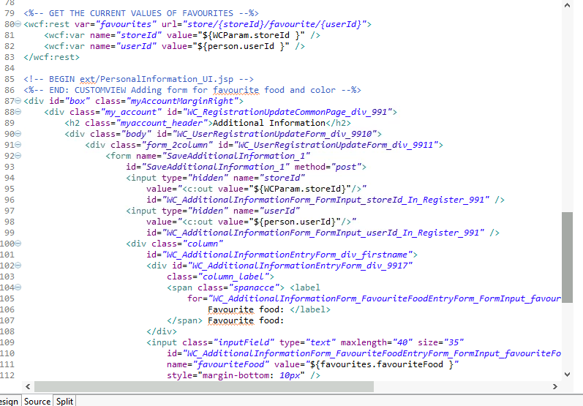
Important areas of the Project with screenshots
FavouriteInfoForm.jspf

Slide 37
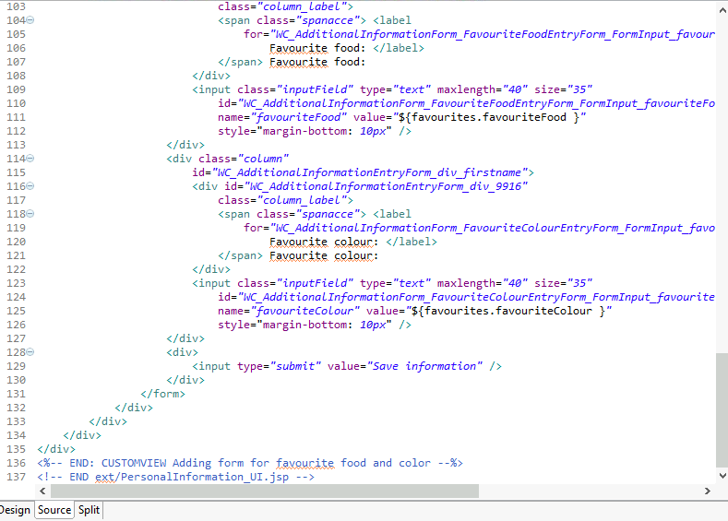
Important areas of the Project with screenshots
FavouriteInfoForm.jspf

Slide 38
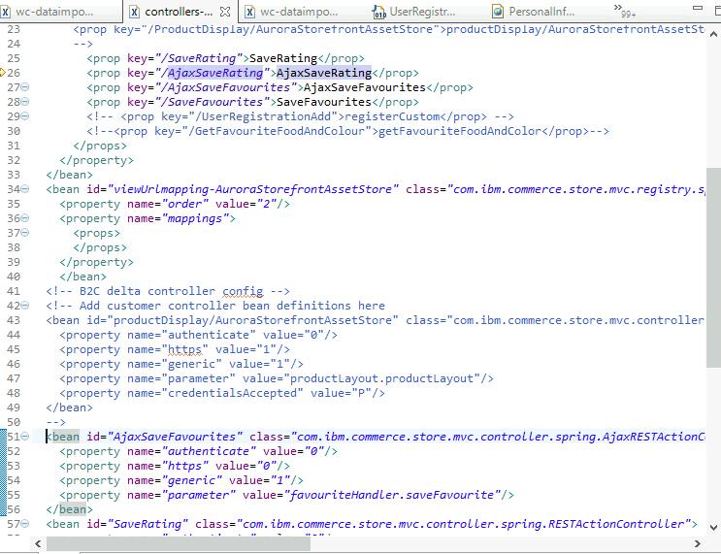
Important areas of the Project with screenshots
controller-ext.xml for mapping request paths to specific beans that calls specific request path back to Transaction server

Slide 39
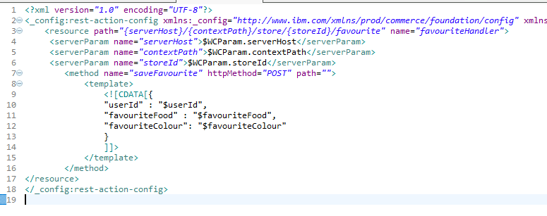
Important areas of the Project with screenshots
rest-template-config.xml for Favourite save request
Store server maps the parameters of the request it receives to the request it will send to the Transaction server

Slide 40
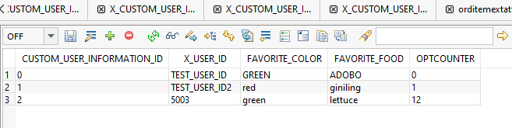
Important areas of the Project with screenshots
Custom table for storing favourites

Slide 41
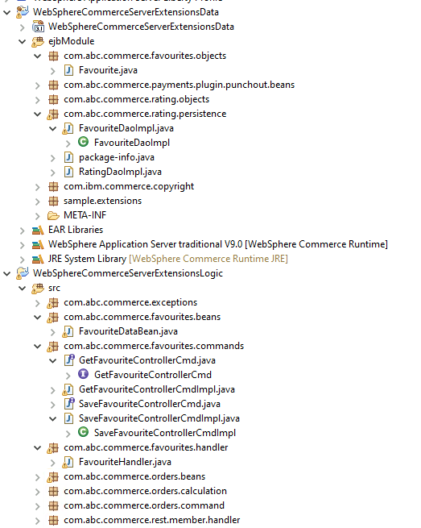
Important areas of the Project with screenshots
Favourite food and colour related files inside WebSphereCommerceServerExtensionData and WebSphereCommerceServerExtensionLogic

Slide 42
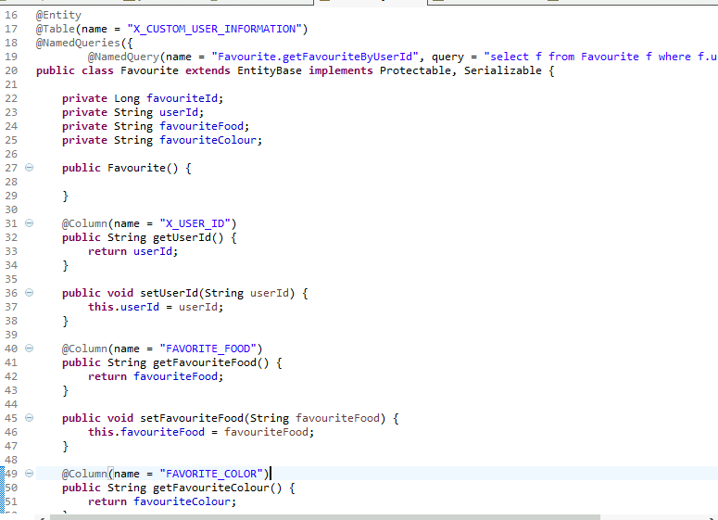
Important areas of the Project with screenshots
Favourite @Entity class

Slide 43
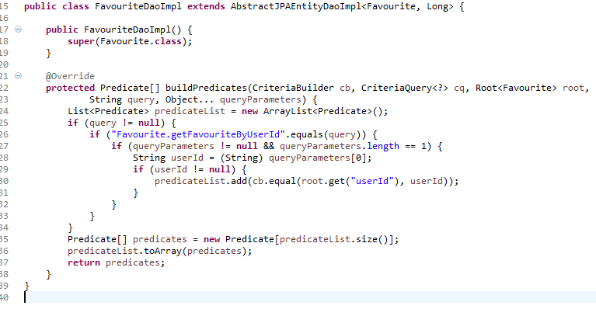
Important areas of the Project with screenshots
FavouriteDaoImpl class

Slide 44
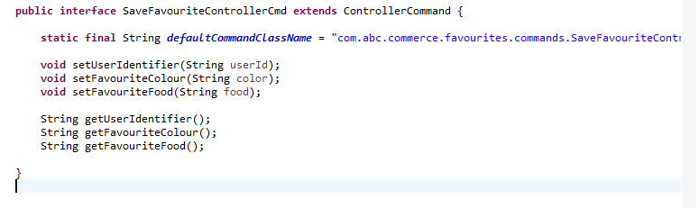
Important areas of the Project with screenshots
SaveFavouriteControllerCmd, the Controller Command responsible for handling save/update Favourite

Slide 45
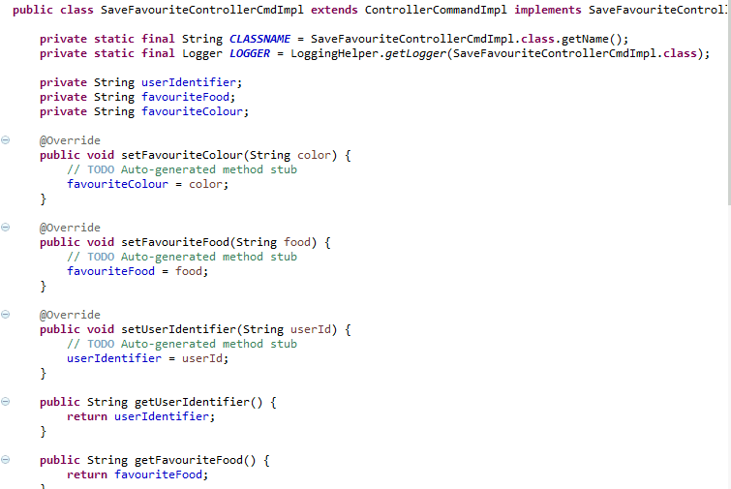
Important areas of the Project with screenshots
SaveFavouriteControllerCmdImpl, the implementation class for the SaveFavouriteControllerCmd

Slide 46
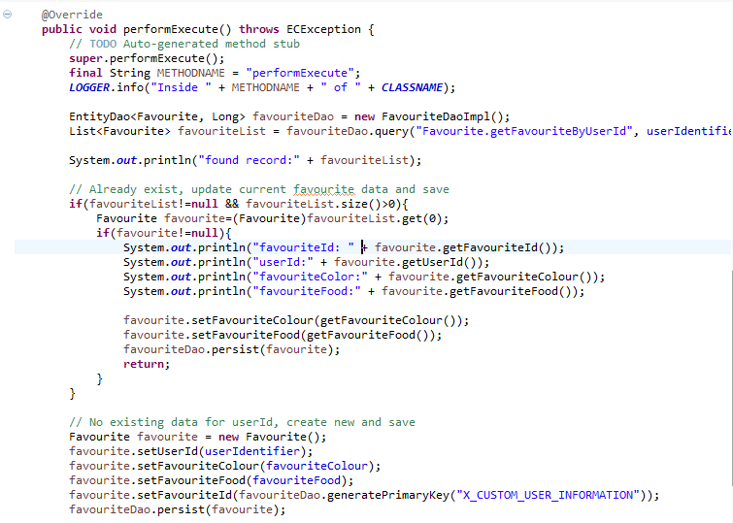
Important areas of the Project with screenshots
SaveFavouriteControllerCmdImpl’s performExecute that contains the logic for saving/updating Favourite

Slide 47
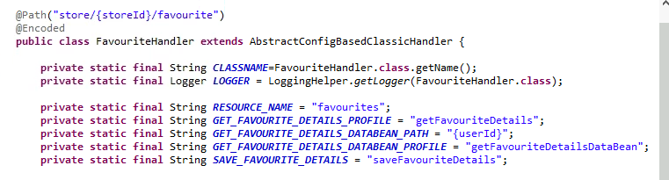
Important areas of the Project with screenshots
FavouriteHandler, handler class that where we define the endpoints to expose and receive request

Slide 48
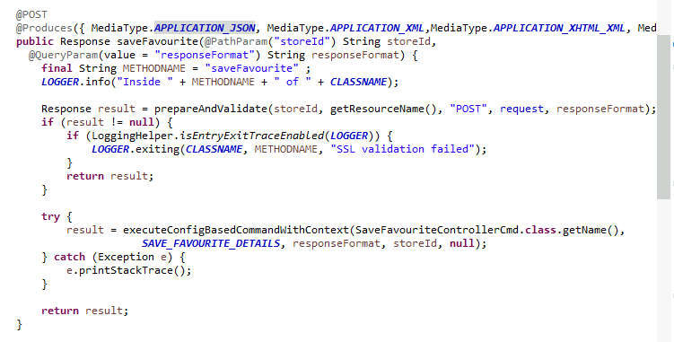
Important areas of the Project with screenshots
FavouriteHandler’s @POST endpoint for receiving request for saving favourite. It uses the SaveControllerCmd

Slide 49
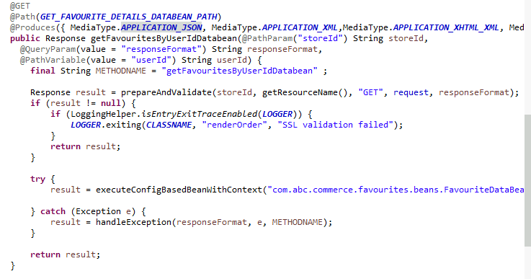
Important areas of the Project with screenshots
FavouriteHandler’s @GET endpoint for receiving request to access the favourites. It uses the FavouriteDataBean

Slide 50
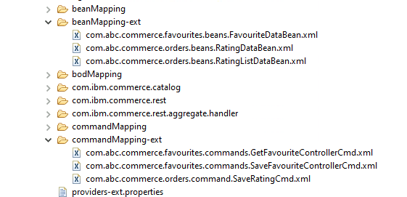
Important areas of the Project with screenshots
Custom bean and command mapping

Slide 51

Important areas of the Project with screenshots
“getFavouriteDetailsDataBean” Profile definition for mapping request parameter and response body to/from FavouriteDataBean methods

Slide 52

Important areas of the Project with screenshots
“saveFavouriteDetails” Profile definition for mapping request parameter and response body to/from SaveFavouriteControllerCmd methods

Slide 53

Important areas of the Project with screenshots
resources-ext.properties where we register custom handler classes

Slide 54
Conclusion
During the training, we learn a lot about the HCL Commerce, which includes but not limited to:
HCL Commerce history, uses and benefits
WCS V8 and WCS V9
Brief introduction to E-Commerce
Frameworks and Technologies used
Utilities and Management consoles available
Extension and Customization points
While doing the capstone, I was able to utilize most, if not all, of the knowledge I gained during the training. And the trainers also guided us during training by answering all of our queries with regards to capstone
Overall, I am satisfied with the result of the training and I feel like I have enough knowledge to tinker, and face issues related to HCL Commerce development

Slide 55
Thank You
www.collaberadigital.com

